Slide 1
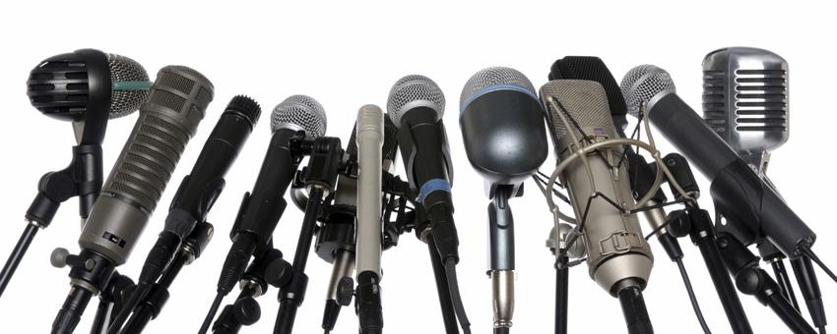
MDA Bowling Event Public Relations Campaign & Press Release
By
Jared Kroll
Yash Patel
Noah Warren
Tom Schumacher
7th hr.

Slide 2
Executive Summary
Objectives
Raise money for Muscular Dystrophy Association
Recruit 8-16 teams of 4 people from Mosinee High School area
Fundraising opportunities such as raffles, auctions, and contests
Donations and cash sponsorships

Slide 3
Target Population
Mosinee High School students
Mosinee DECA members
Mosinee community
Surrounding schools from Wausau area
Local businesses

Slide 4
Promotional Activities
Mainly using internet to reach target population
Facebook page
Twitter account
Mosinee High School calendar
And other ideas

Slide 5
Other Ideas
Put signs or posters in local shops
Submit info to online blogs
Make and handout flyers
Word of mouth
Free internet advertising

Slide 6
Promotional Activities Video

Slide 7
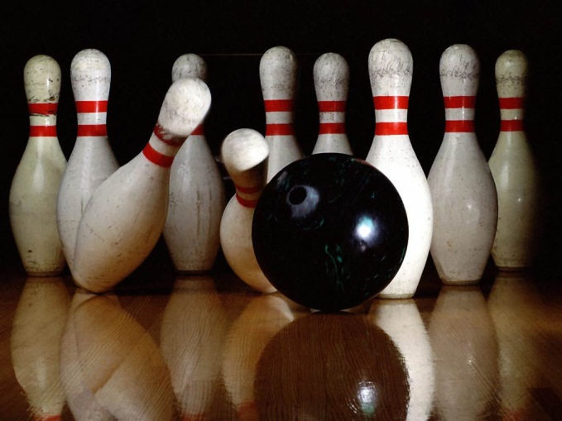
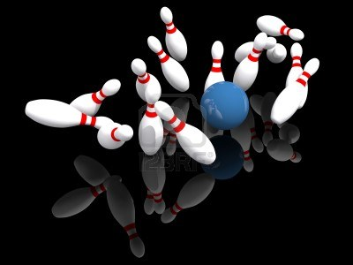
Press Release
MDA Bowling Event: Bowling for a Good Cause and a Lot of Fun
December 15th at 5:00 p.m. at Paper City Lanes
DECA hosted event & proceeds go to MDA
Fun event at low price
Follow us on Facebook and Twitter

Slide 8
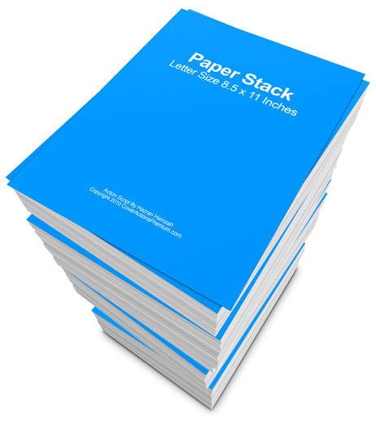
Implementation Plan
Use internet to reach target population
Social media = Easy + Effective
Involve local businesses to promote event by making flyers
Press release talks about positive results of MDA event

