Slide 1
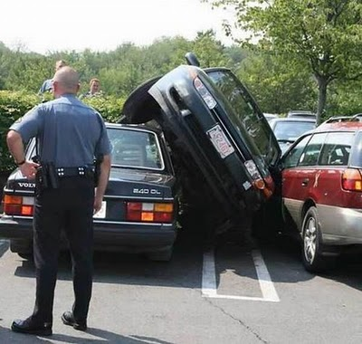
Need Glasses?
The Gift of Sight. Hand-Delivered.

